Slide 1
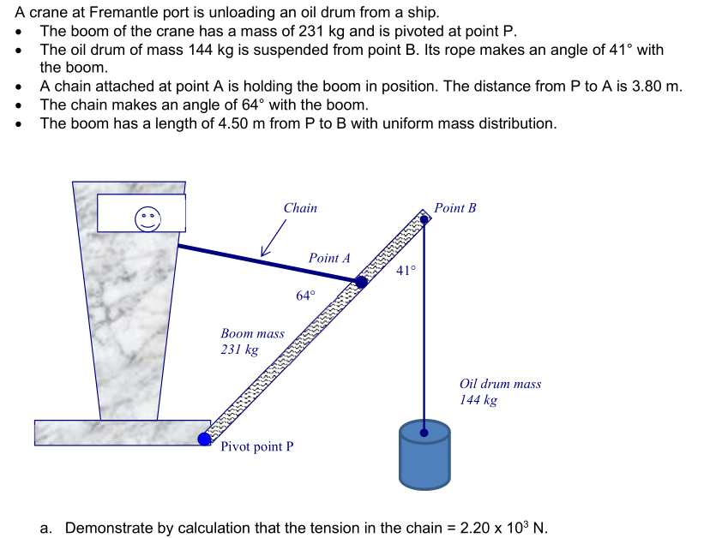
Static and Rotational Equilibrium

Slide 2


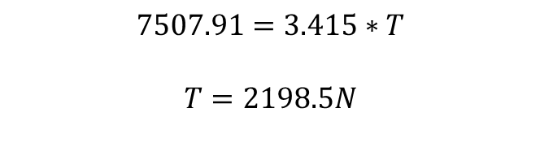
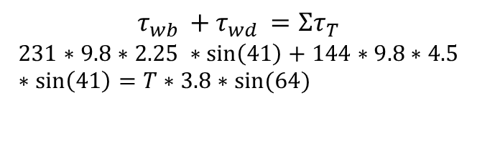

Static and Rotational Equilibrium GUIDE
Step 1: Draw or annotate the picture
Identify and label the forces acting
#marks: None
Helps you identify all the torques and forces
Tells marker what your symbols means
T
W_{d}
W_{b}
R
Step 2: Static equilibrium equation
State the static equilibrium condition with the torques
#marks: 1
$$Στ=0$$
$$Στ_{cw}=Στ_{acw}$$
Step 3: Substitute values for torques
Substitute the values
#marks: 1 for LHS, 2 for RHS
Remember:
$$τ=F r sinθ$$
Note: R does not provide a torque as it acts at the pivot
Check your angles!
$$τ_{wb }+τ_{wd }=Στ_{T}$$
$$231∗9.8∗2.25 ∗\sin\left(41\right)+144∗9.8∗4.5∗\sin\left(41\right)=T∗3.8∗sin⁡(64)$$
Step 4: Solve for the unknown force
Evaluate the expression
#marks: 1
$$7507.91=3.415∗T$$
$$T=2198.5N$$
Step 5: Express to the correct significant figures with units
#marks: 0 to 1
$$T=2.20 ∗{10}^{3} N$$
Remember:
3 sig figs normally
2 sig figs for estimates

Slide 3
Static and Rotational Equilibrium YOU DO
Step 1: Draw or annotate the picture
Identify and label the forces acting
#marks: None
Helps you identify all the torques and forces
Tells marker what your symbols means
Step 2: Static equilibrium equation
State the static equilibrium condition with the torques
#marks: 1
Step 3: Substitute values for torques
Substitute the values
#marks: 1 for LHS, 2 for RHS
Remember:
$$τ=F r sinθ$$
Note: R does not provide a torque as it acts at the pivot
Check your angles!
Step 4: Solve for the unknown force
Evaluate the expression
#marks: 1
Step 5: Express to the correct significant figures with units
#marks: 0 to 1
Remember:
3 sig figs normally
2 sig figs for estimates

